Slide 1
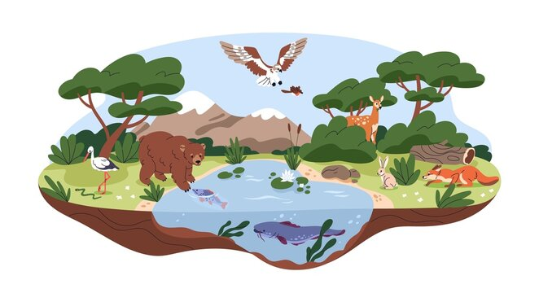
Living Things
A Cross-Curricular Approach
A BEN Workshop

Slide 3
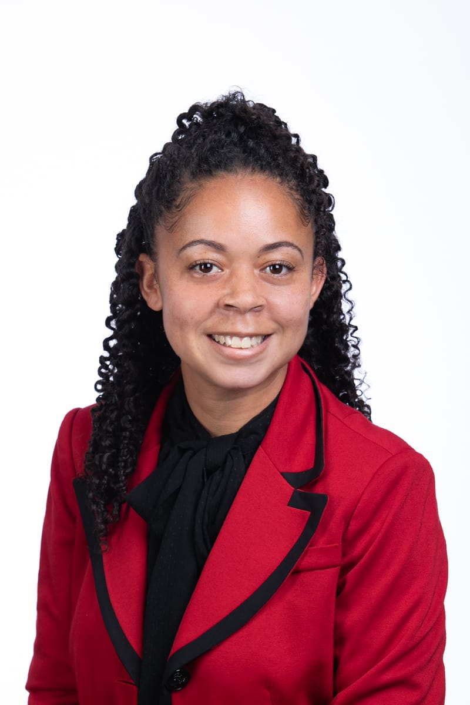
J’Ree Burgess
My name is J’Ree Burgess. I am a teacher within the Bermuda Public School System (BPSS). I have taught primary two for four years. Currently, this is my second year teaching primary three. I have taught at Paget Primary School for all six years.
I am the mathematics teacher leader at Paget Primary School. I have joined as a BEN network teacher due to my love of cross curricular teaching and high interests in teaching science and social studies.
Notes:
2 mins.

Slide 4
Why are fish so smart?
Because they live in schools!
Notes:
2 mins.

Slide 5
Lesson 1: Habitats
Introduction to Habitats
A habitat is a place where animals and plants live. Living things (plants and animals) get food, water and shelter from their habitat, which keeps them alive. There are many different habitats in the world (ocean, desert, rainforest etc) and many different animals can live in one habitat.
Habitats Lesson
Play the Habitats song for students to sing along with.
Read the book World Beneath our Waves
Ask students to identify the habitat that was shown/presented in the book. Make a list of habitats and generate the animals/plants that live in each habitat.
Students will create a habitat diorama with one animal that lives in the habitat.
Plenary/Reflection:
Ask students to define the word habitat.
Cambridge Science Standard:
2Be.01 Know that an environment in which a plant or animal naturally lives is its habitat.
Cambridge ELA Standard:
2Wv.01 Use vocabulary relevant to a familiar topic.
2Rs.01 Talk about the sequence of events or ideas in a text.
2Ri.13 Answer simple questions from reading a short text.

Slide 6
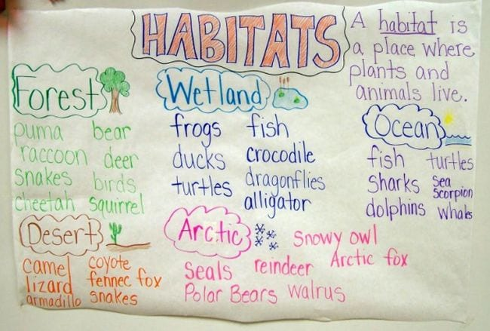
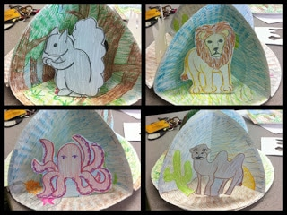
Habitat Anchor Chart
Habitat Diorama

Slide 7
Lesson 2: Various Animals Various Habitats
Introduction:
A habitat is a place where animals and plants live. Living things (plants and animals) get food, water and shelter from their habitat, which keeps them alive. There are many different habitats in the world (ocean, desert, rainforest etc) and many different animals that can live in one habitat.
Main Activity:
Provide students with statements from prior lesson. Students will choose whether the statements are true or false.
Students will view the Habitat video. Ask students to identify the habitats shown in the video and the animals in each habitat. Compile a list on an anchor chart. Allow students to observe that many animals live in each habitat. For example: Ocean habitat: Octopus, and fish.
Students will create a sorting mat with 3 different habits and include the different animals that live in each habitat.
Plenary/ Reflection:
Gallery walk of sorting mat. Students place completed maps on their desks as everyone walks around the room to admire them. Allow students to explain why they chose certain habitats and animals.
Cambridge Science Standard:
2Be.02 Know that different habitats contain different plants and animals.

Slide 8
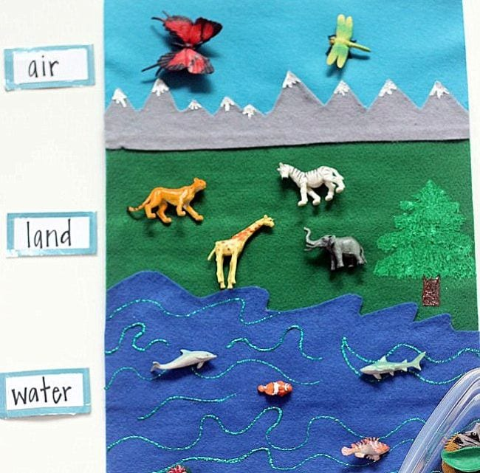
Habitat Sorting Mat

Slide 9
How do bees get to school?
By school buzz!
Notes:
2 mins.

Slide 10
Lesson 3: Exploring Local Habitats
Introduction:
A habitat is a place where animals and plants live. Living things (plants and animals) get food, water and shelter from their habitat, which keeps them alive. There are many different habitats in the world (ocean, desert, rainforest etc) and many different animals that can live in one habitat.
Main Activity:
Show students pictures of different habitats (local and overseas).
Ask students to think about the differences between the habitats. (Some habitats are not in Bermuda)
Ask students to group the local habitats only
Allow students to discuss the similarities and differences of the local habitats.
Students will choose two local habitats and compare and contrast each habitat on a Venn Diagram.
Plenary/ Reflexion:
Writing activity: Students will choose one local habitat they would like to live in if they were an animal and explain why.
Cambridge Science Standard:
2Be.03 Identify similarities and differences between local environments in terms of hot, cold, dry, wet, many plants, few plants, many animals and few animals.
Cambridge ELA Standard:
2Ws.02 Group together sentences relating to similar ideas.

Slide 11
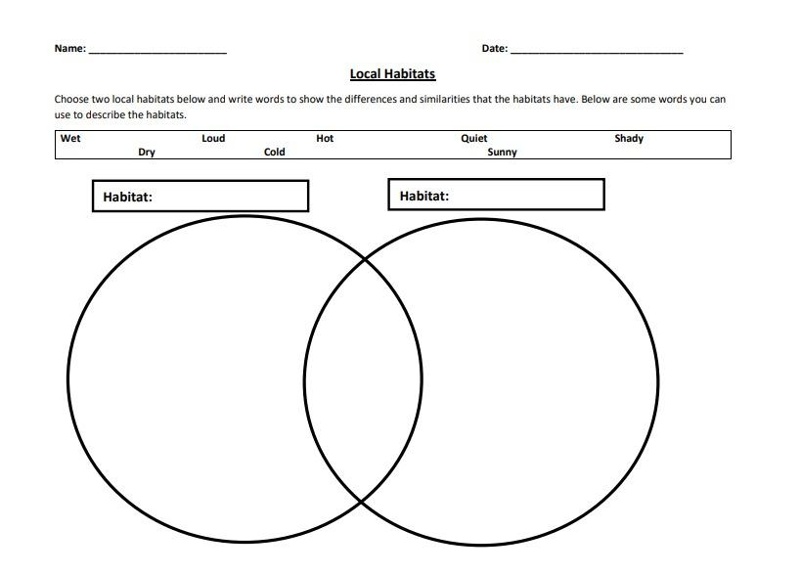

Slide 12
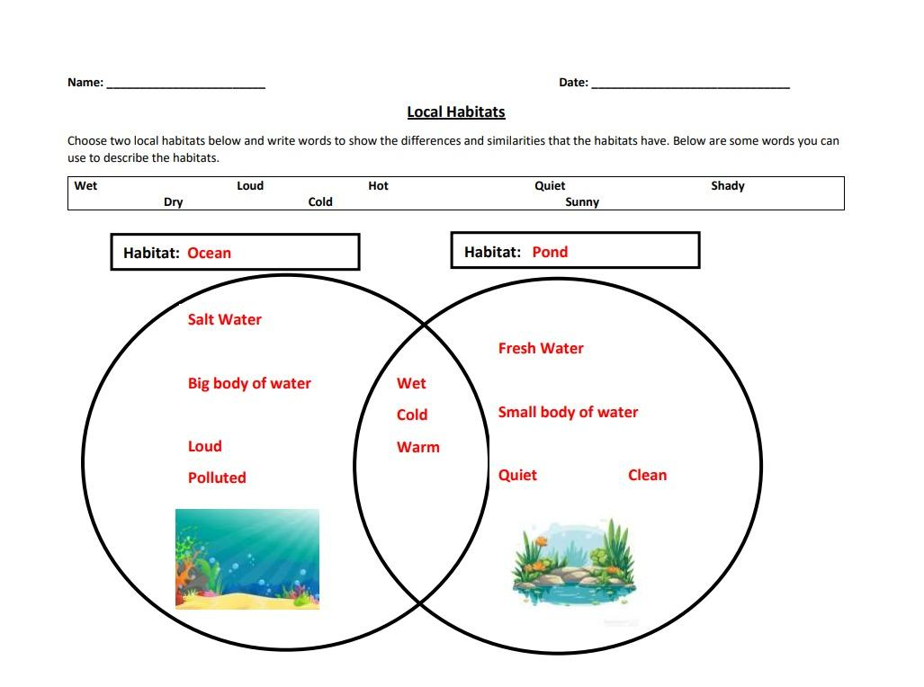

Slide 13
Lesson 4: Habitat Guess!
Introduction:
A habitat is a place where animals or plant live. Living things (plants and animals) get food, water and shelter from their habitat, which keeps them alive. There are many different habitats in the world (ocean, desert, rainforest etc) and many different animals that can live in one habitat. Different habitats can also have different animals that live in each habitat.
Main Activity:
Complete a review activity with students on Habitats (Kahoot, True/Fale, Pen/Paper etc).
Place students in groups and provide each group with a habitat.
In their groups, students will create a habitat using materials provided. (The habitat created must include the plants and animals that live within the habitat).
Each group will guess the habitat that the other group has created.
Plenary/ Reflexion:
Students will write which habitat they liked the best and explain why.
Cambridge ELA Standard:
2Wg.04 Write clear statements, commands/instructions and questions.

Slide 14
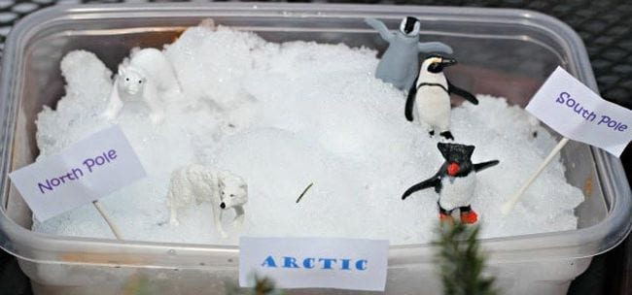
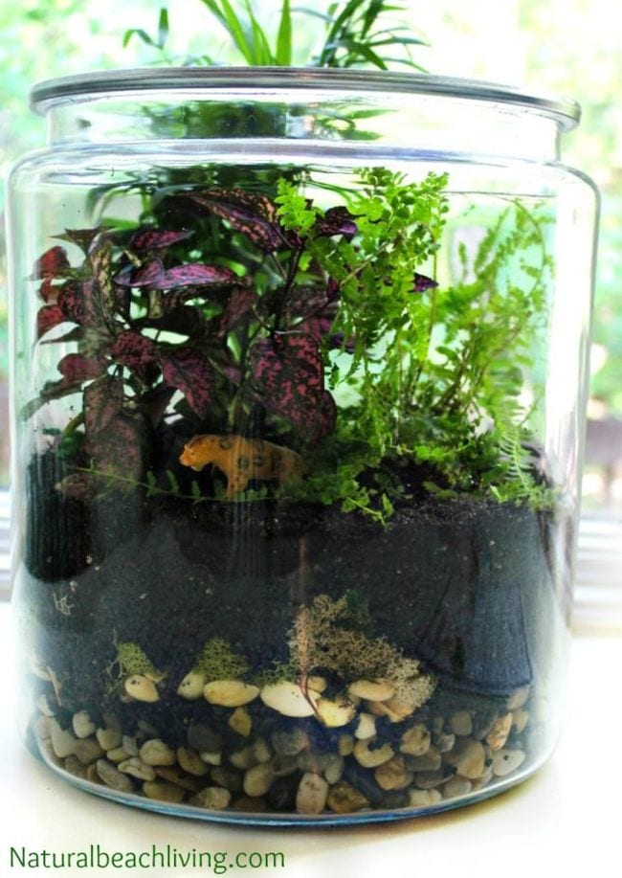
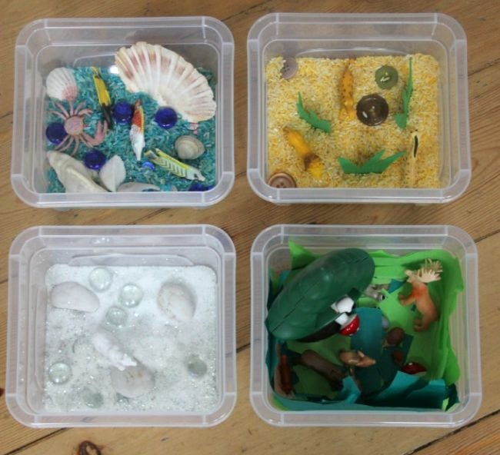
Habitat Guess!

Slide 15
Link to Teacher Resources
The lesson plans and slides will be shared on the BEN website:
http://www.bermudaeducationnetwork.com/what-we-do/lesson-plans/

Slide 16
Keep in touch!
Feedback Form Link:
https://docs.google.com/forms/d/e/1FAIpQLSd7q1VWaWz1CB4VUB-yOvuC7XeBBfYWjmaH46ftHvt1vtpQyQ/viewform
We will be asking for your feedback on this unit:
what went well;
what challenges there were;
where you brought in your own ideas and resources; and
learning that you saw in your class and in what ways.
This will help us for next year..
Thank you for attending. Please can you complete this Google Form providing feedback on our workshop.
To share any learning in action from this cross-curricular unit, please email photos to Steph at stephanie@ben.bm - and let her know if you want to be tagged! Photos will then be posted on Instagram and FB.
***Please make sure waivers are checked, or take photos of work.

