Slide 1

Pirate

Slide 2
Captain

Slide 3
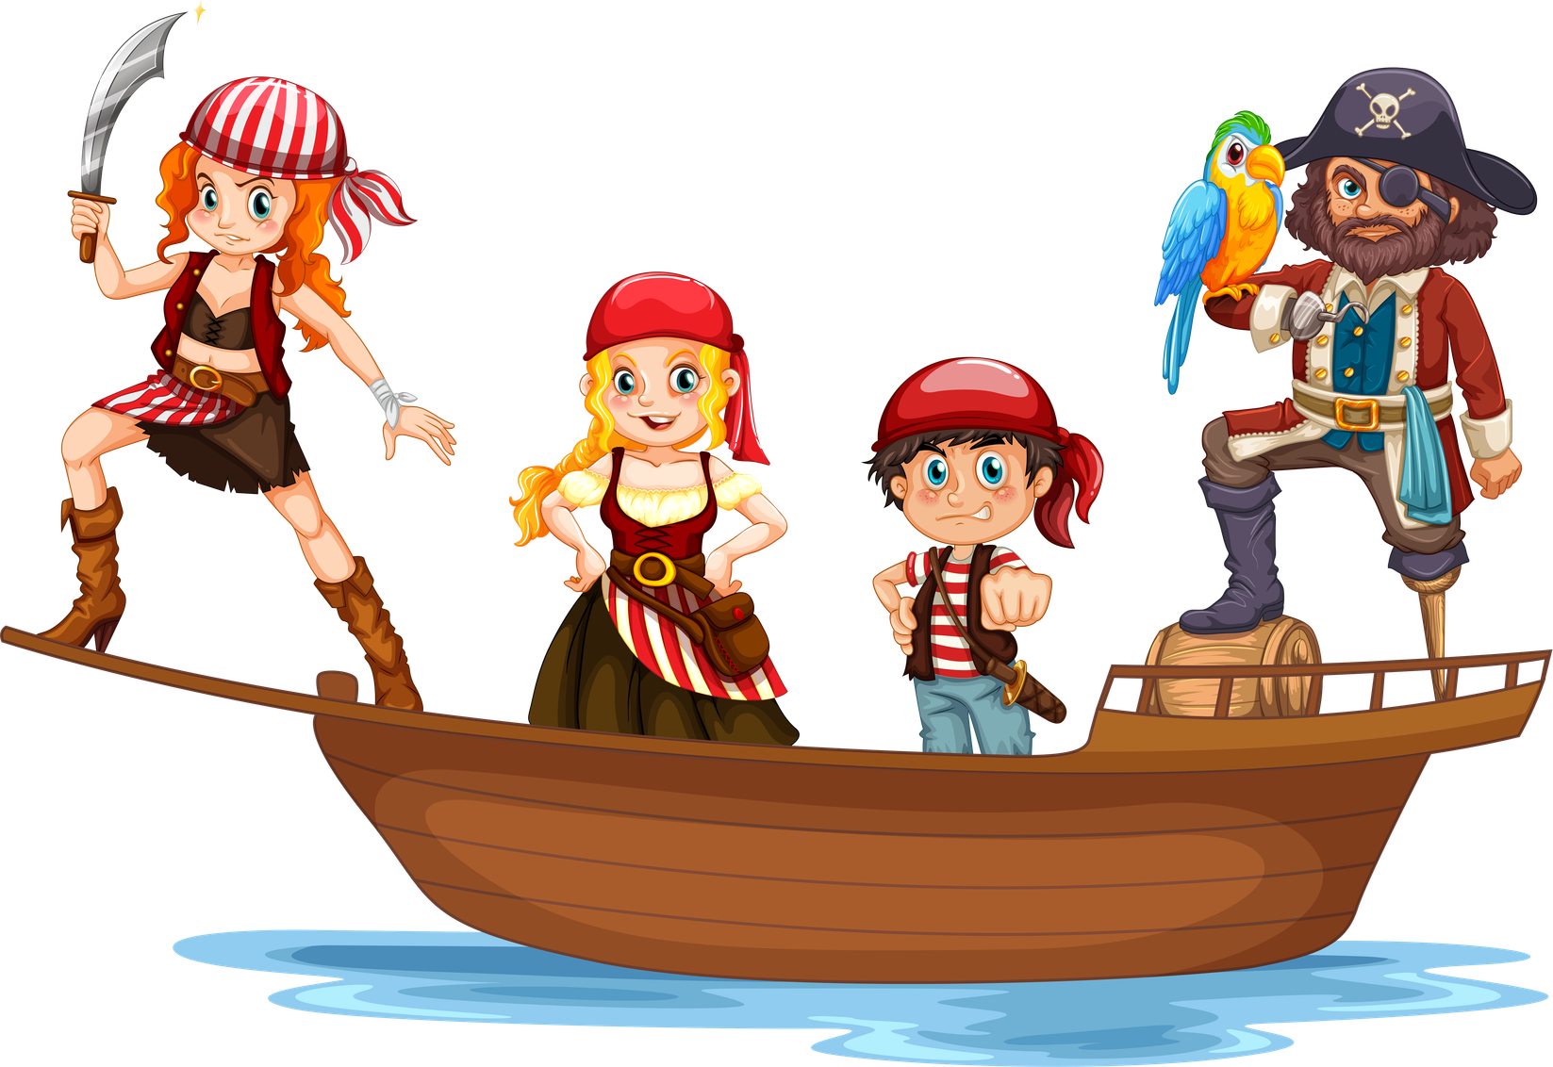
Crew

Slide 4

Ship

Slide 5

Sail

Slide 6

Anchor

Slide 7
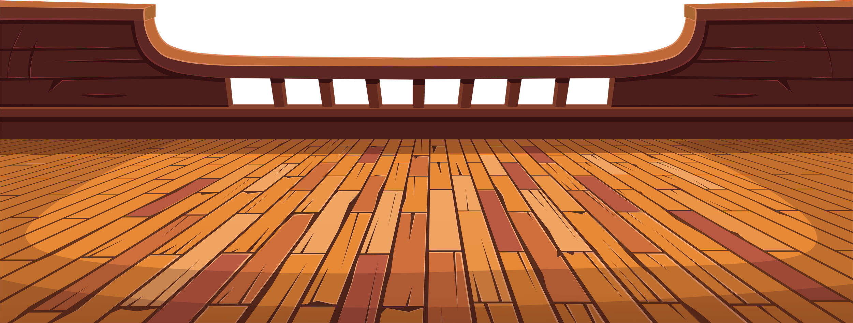
Deck

Slide 8

Lookout

Slide 9
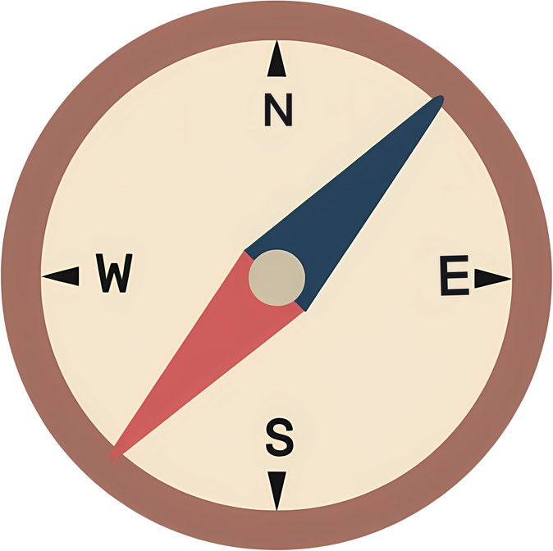
Compass

Slide 10

Treasure

Slide 11
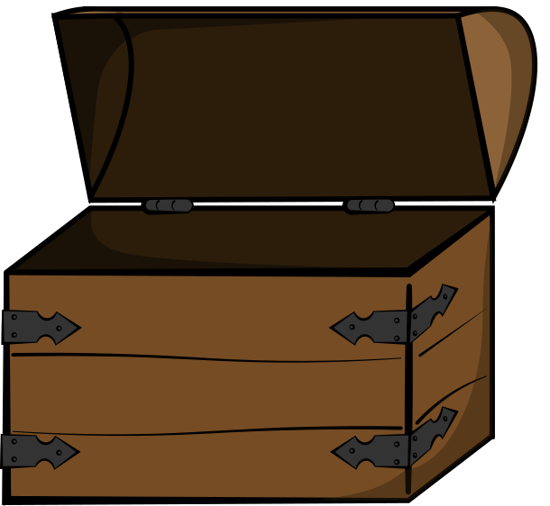
Chest

Slide 12

Voyage

Slide 13

Island

Slide 14

Telescope

Slide 15

Sword

Slide 16
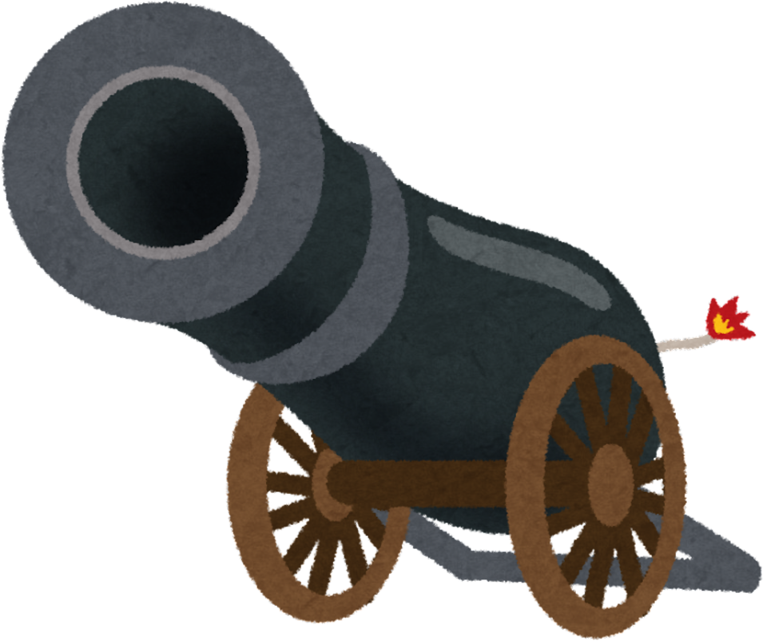
Cannon

Slide 17

Boat

Slide 18

Storm

Slide 19

First Mate

Slide 20

Navigator

Slide 21

Buccaneer

Slide 22

Swashbuckler

Slide 23

Helm

Slide 24

Harbour

