Slide 1


Slide 2

SUN

Slide 3

MOON

Slide 4
EARTH
🌍

Slide 5

STAR

Slide 6
PLANET
🪐

Slide 7
ROCKET
🚀

Slide 8
ASTRONAUT
🧑‍🚀

Slide 9
TELESCOPE
🔭

Slide 10

CRATER

Slide 11

COMET

Slide 12
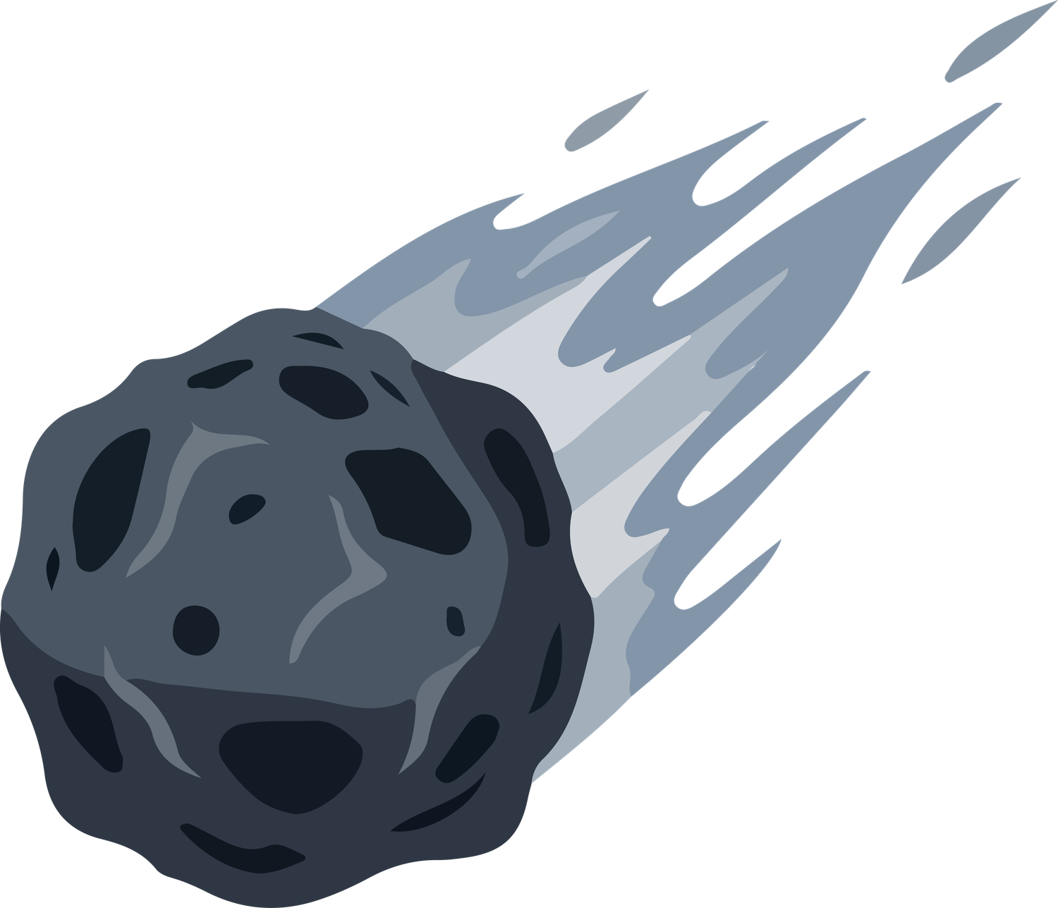
METEOR

Slide 13

GALAXY

