Slide 1



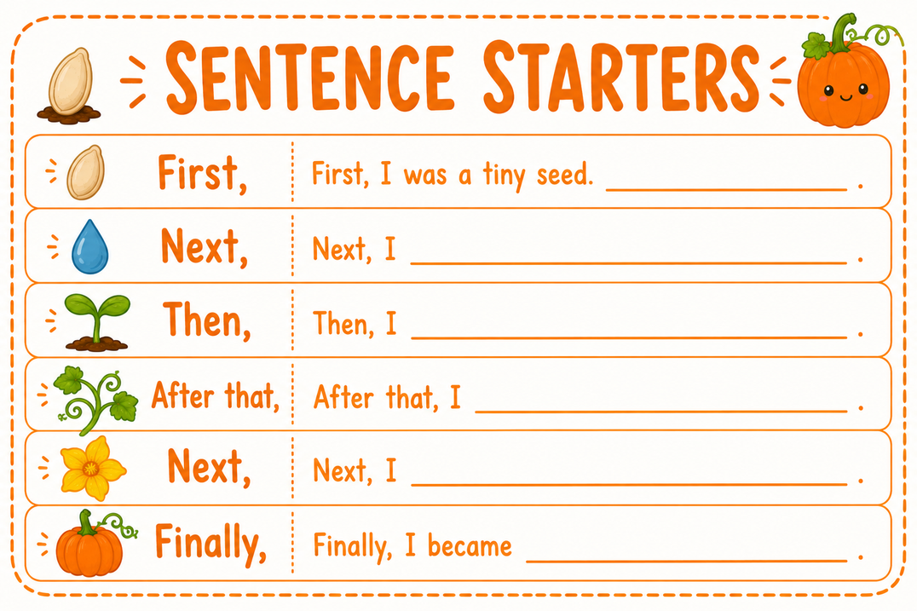
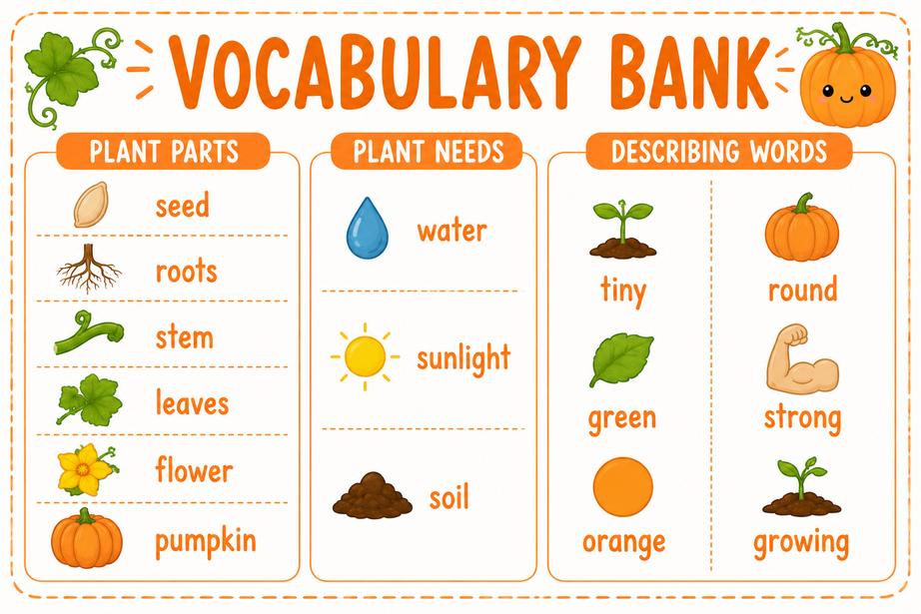

Pretend you are a pumpkin seed and Write about how you grow into a pumpkin! Draw your pumpkin's life cycle.
Tap out the vocabulary words and sentence starters!

