Slide 1



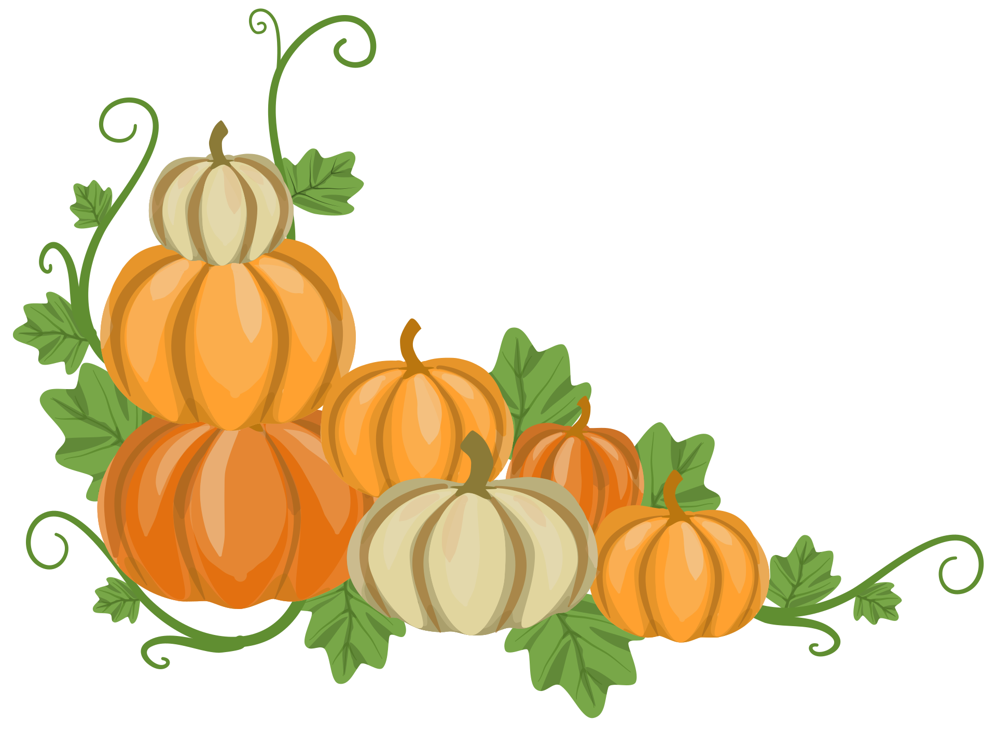
growing our vocabulary!
🎃 Work with your team to answer each question.
🤝 Talk with your teammates before choosing your answer.
🎃 Get it right? Grow your pumpkin patch by 1 pumpkin!
🌻 Get it wrong? Complete the bonus Challenge to earn your pumpkin!
🏆 Keep growing your patch until the game is over.
🎃 The team with the biggest pumpkin patch wins!

Slide 2
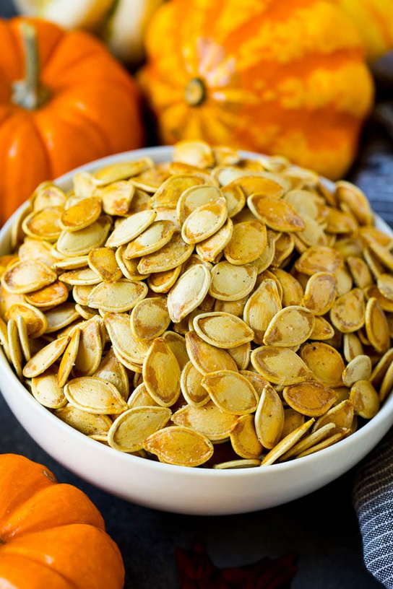
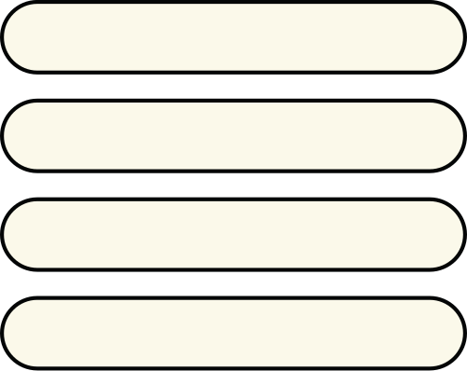
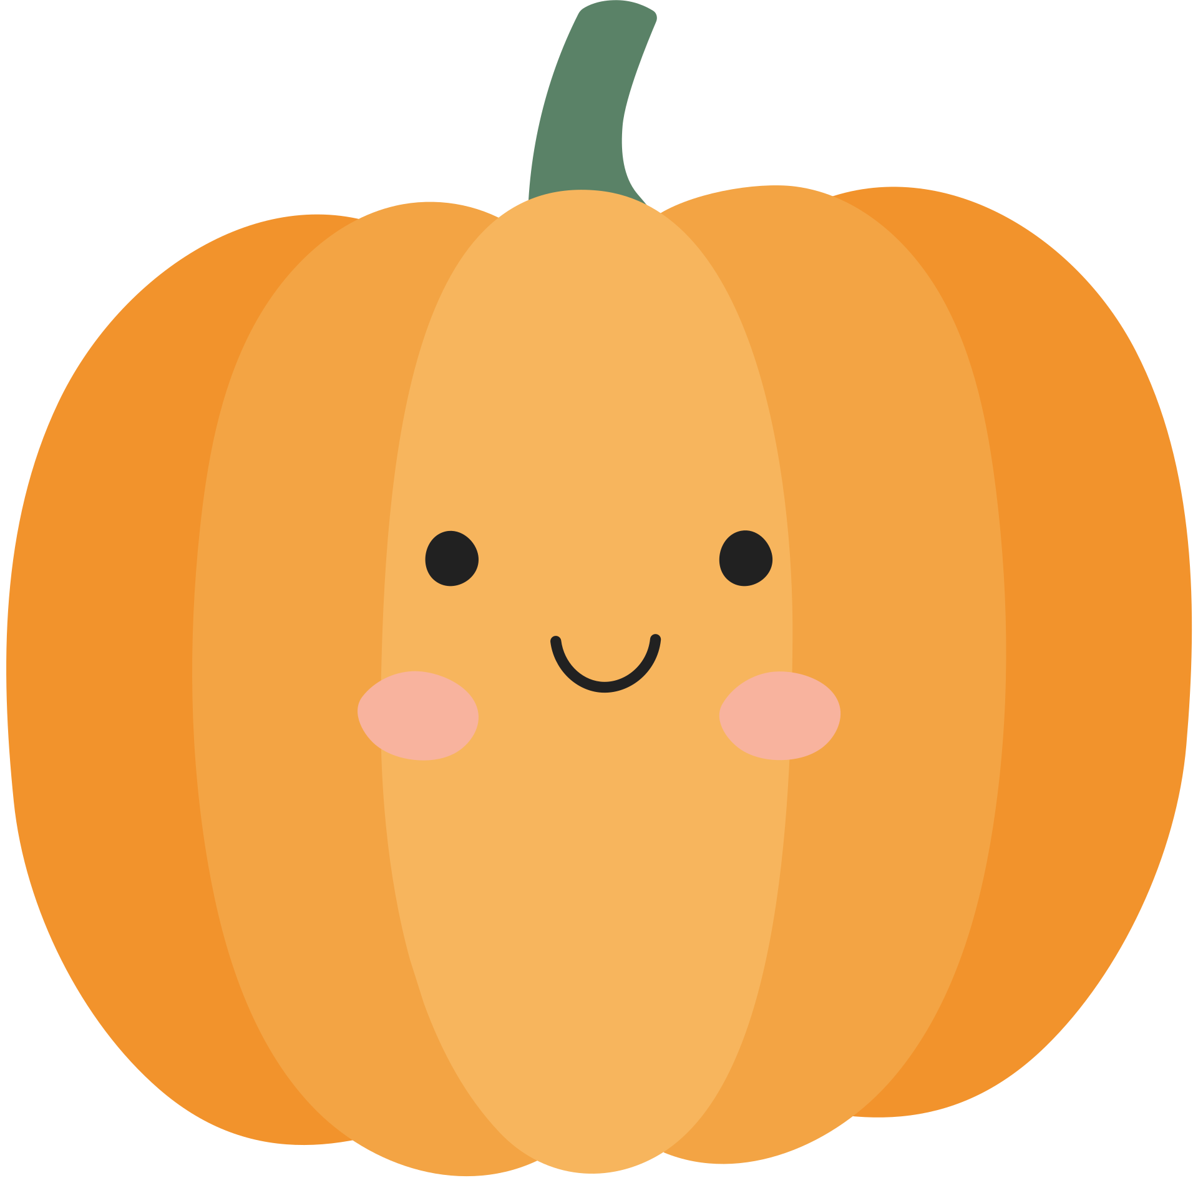
Which word matches the picture?
stem
bonus challenge:
what is one thing a seed needs to start growing?
seed
flower
pumpkin

Slide 3
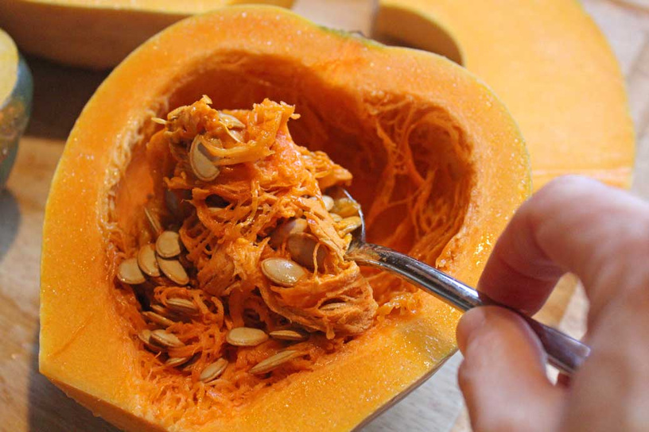
Which word best describes how the pulp feels?
rough
bonus challenge:
use the word slimy to describe a different object.
slimy
dry
hard

Slide 4
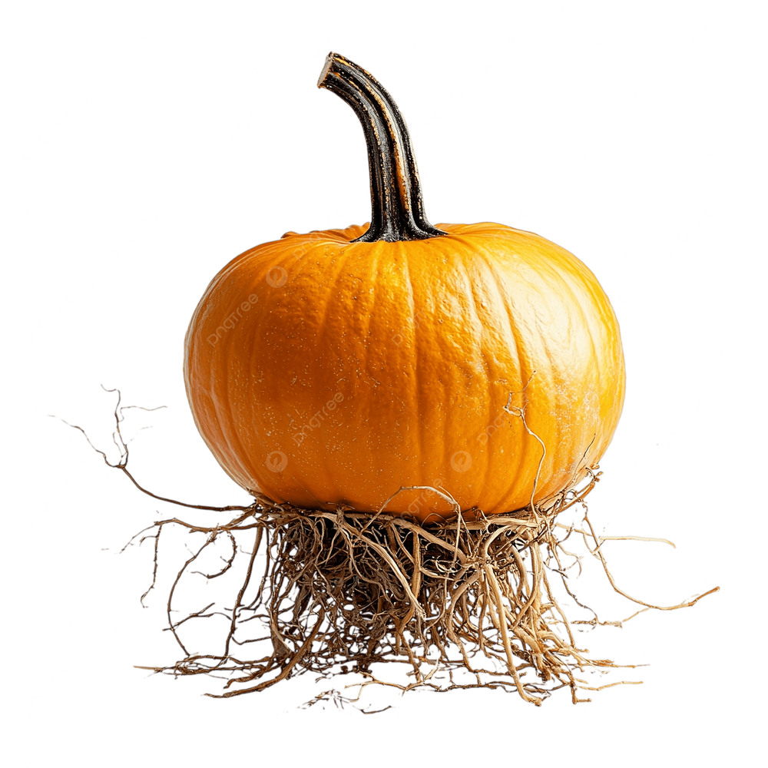

Which part of the plant is this?
flower
bonus challenge:
use the words roots and water in the same sentence.
stem
roots
leaves

Slide 5
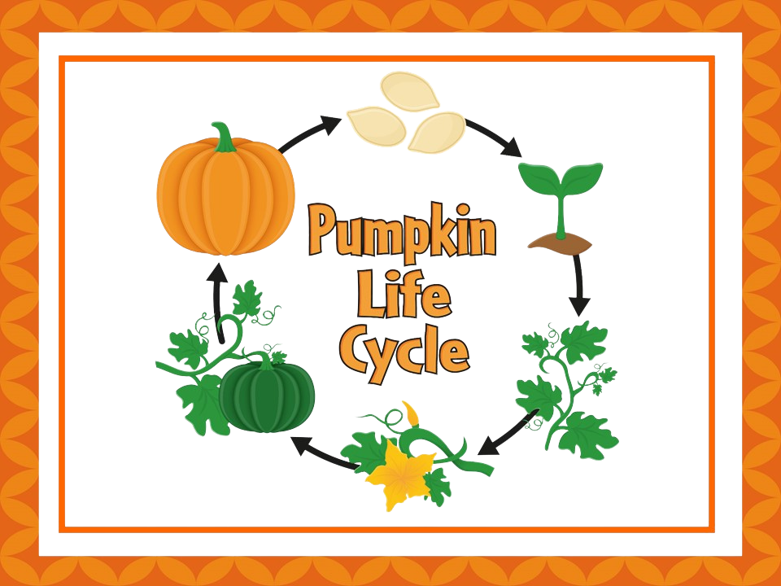
finish the sentence: a pumpkin grows from a ____.
flower
bonus challenge: A seed grows into a _____.
seed
stem
leaves

Slide 6
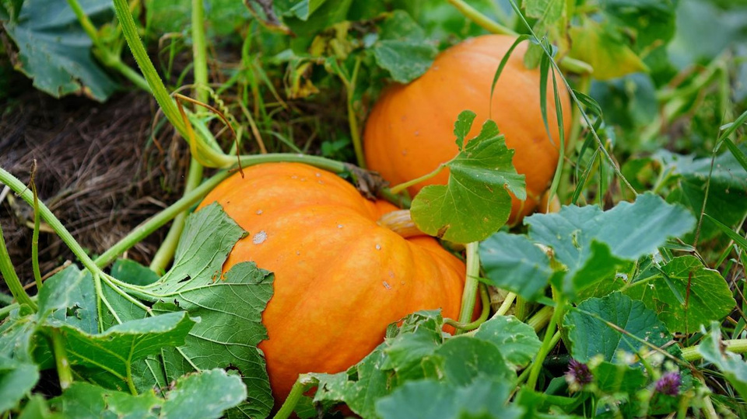
which part of the pumpkin catches the sunlight?
STEM
bonus challenge: use leaves and sunlight in the same sentence.
ROOTS
FLOWERS
leaves

Slide 7
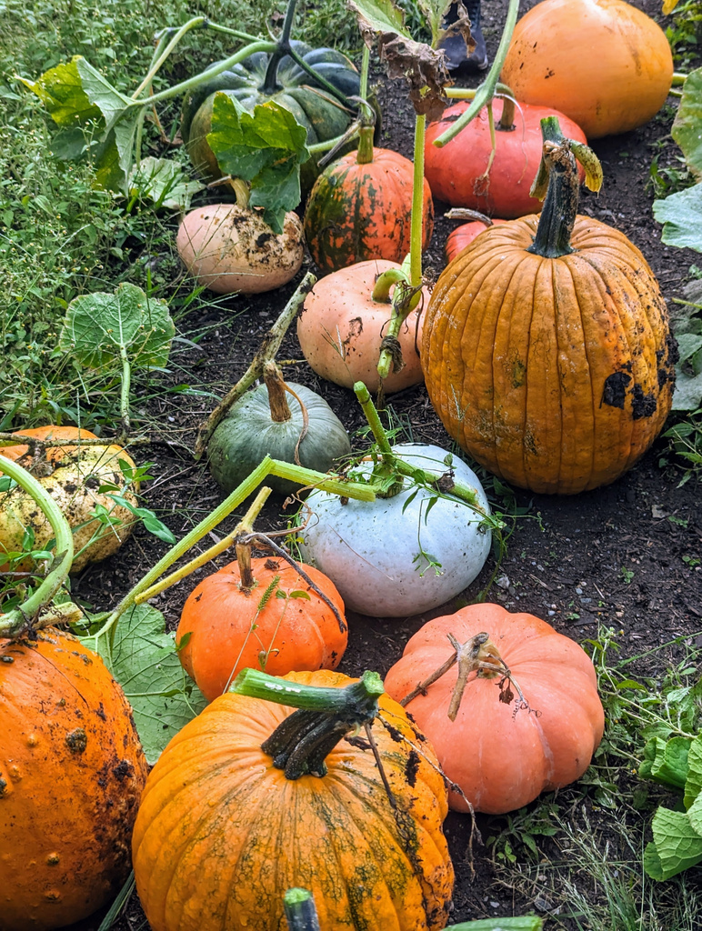
what two things do every pumpkin need to survive?
water & sunlight
bonus challenge: can you think of something else that needs water and sunlight to survive?
water & Leaves
stem & flower
roots & leaves

Slide 8
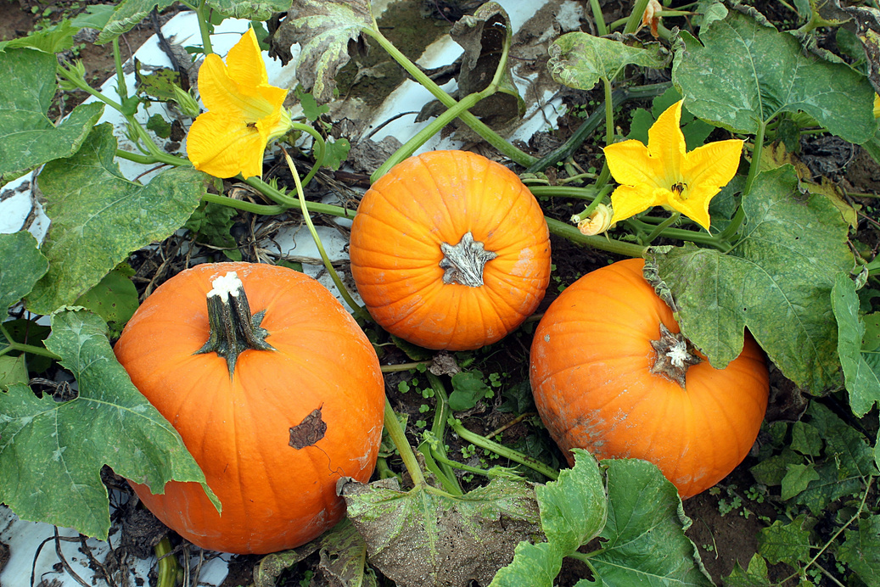
finish the life cycle: seed → stem → ____ → Pumpkin
roots
bonus challenge:
Work together to act out each stage of the pumpkin life cycle without talking.
flower
leaves
water

Slide 9
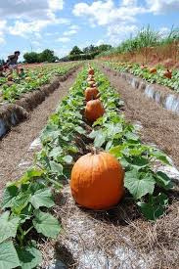
which sentence is correct?
roots drink water
bonus challenge: choose one of the incorrect sentences and fix it!
leaves grow underground
flowers catch water
seeds grow on stems

