Slide 1
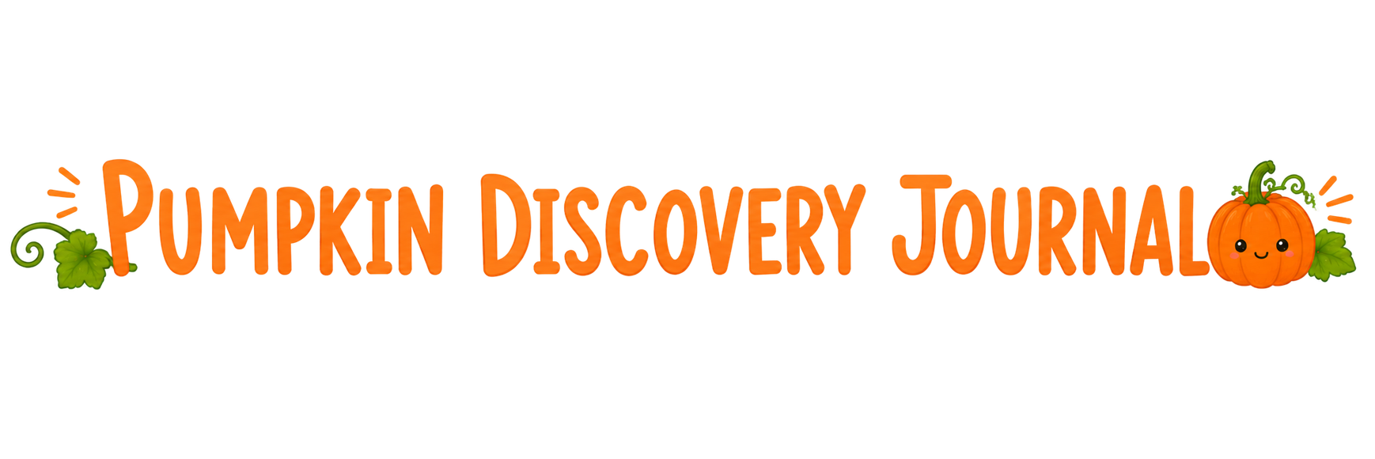
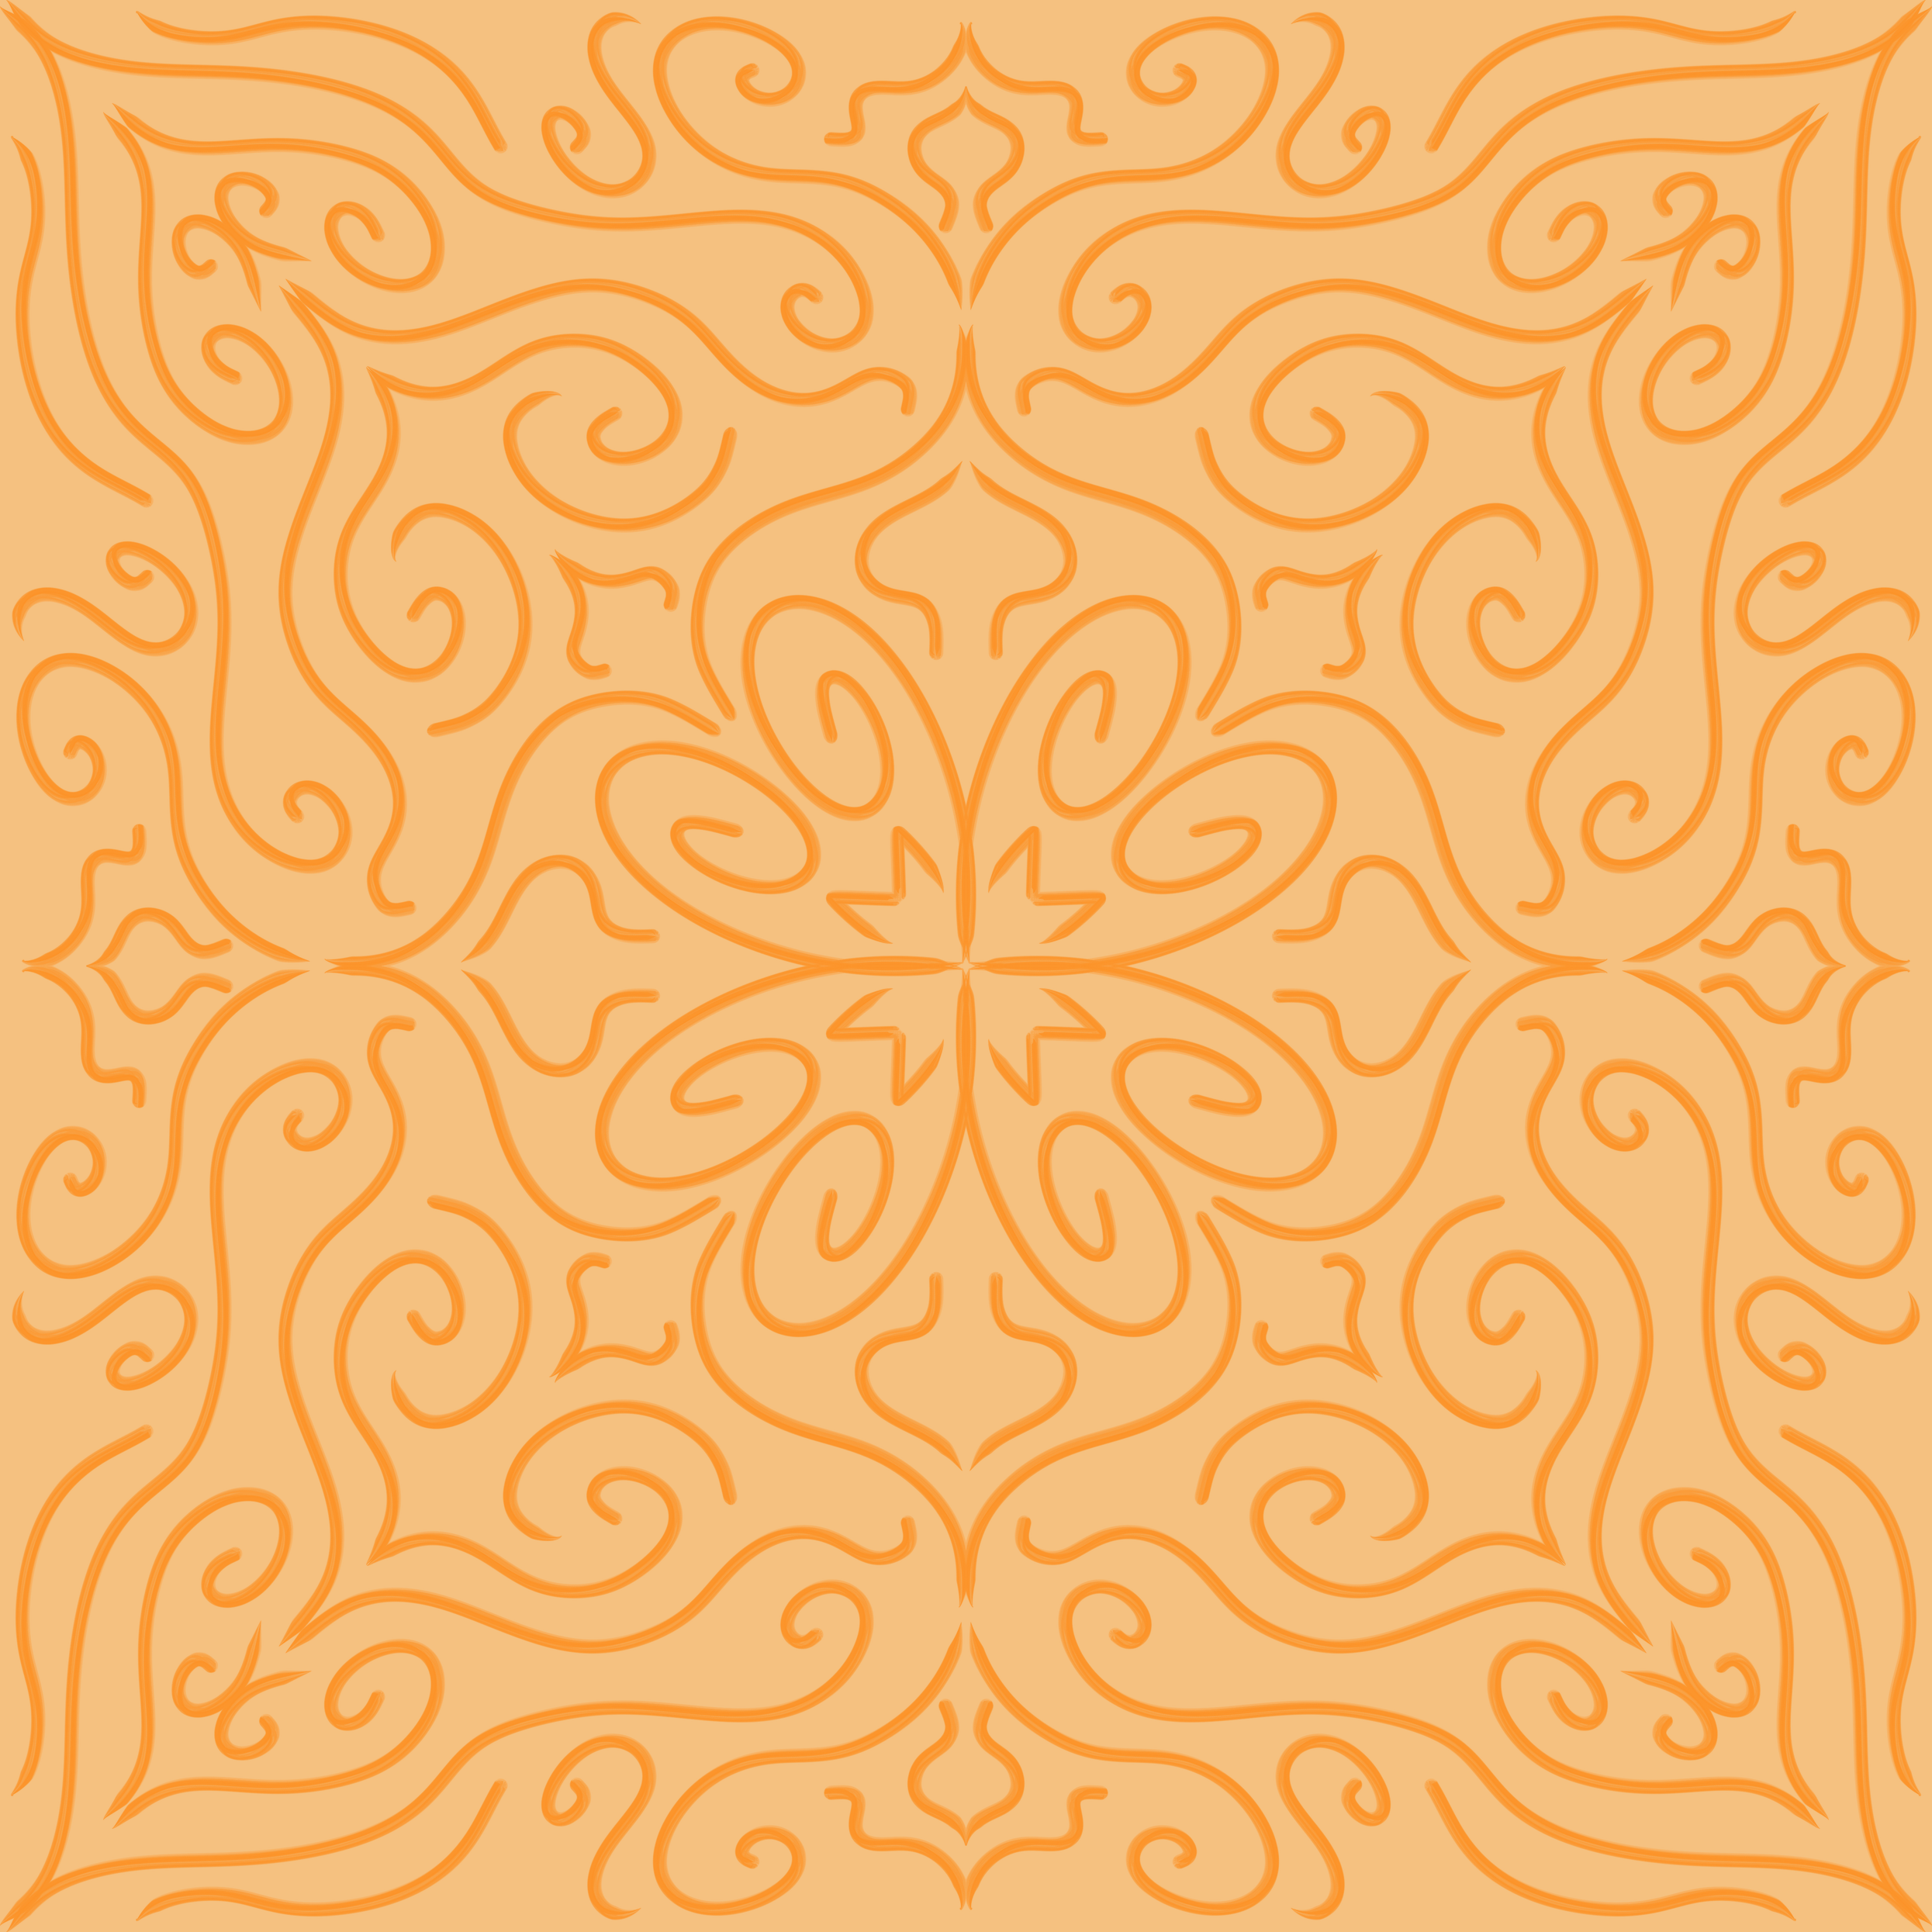

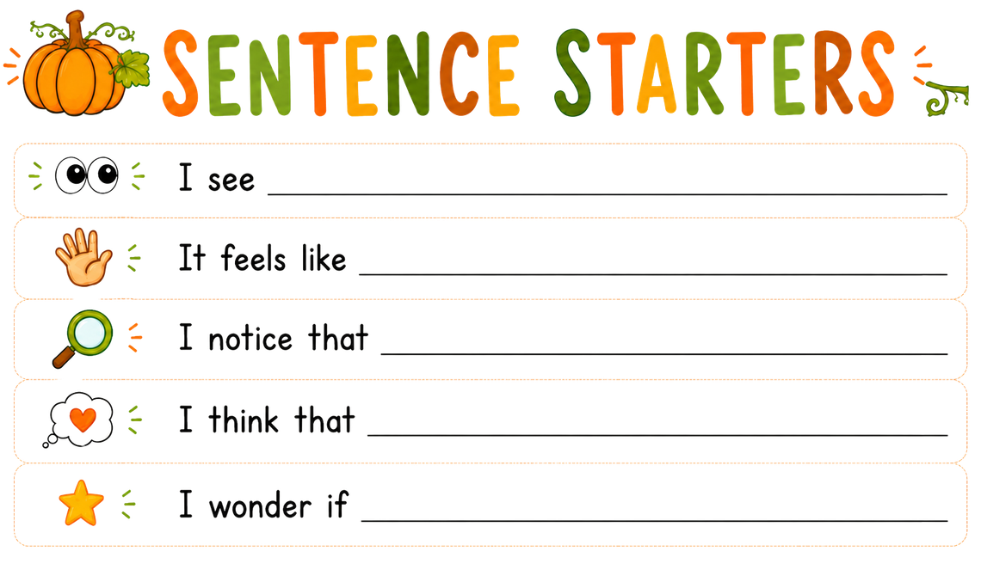
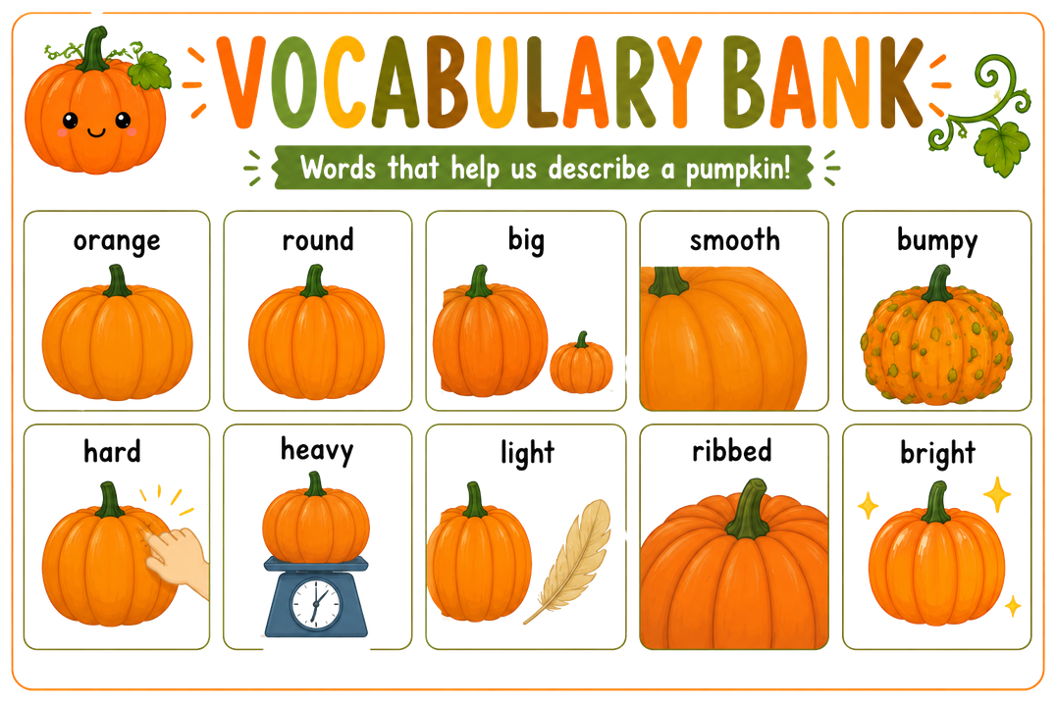
Pretend you are a pumpkin scientist! Think about everything you discovered while exploring the pumpkin.
Write about your observations using the Vocabulary Bank.

