Slide 1


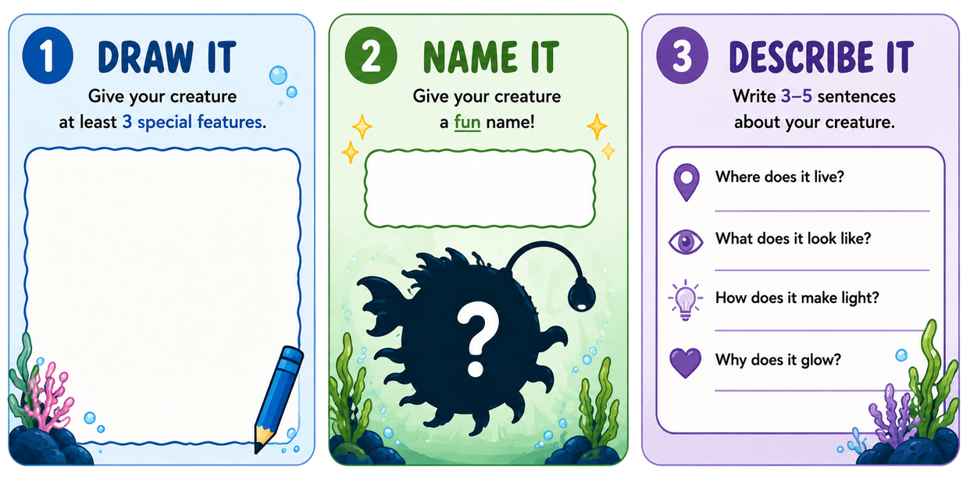
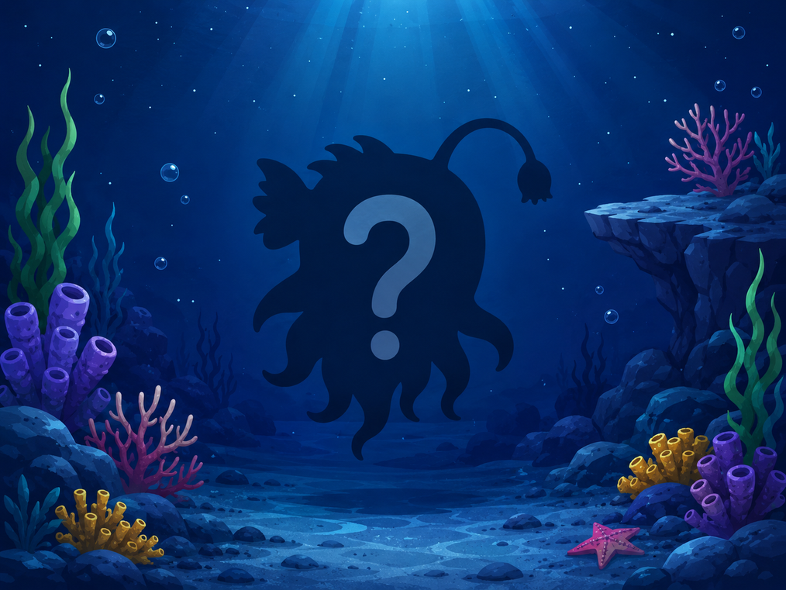
Imagine you are a scientist and you just discovered a new bioluminescent creature!

