Slide 1




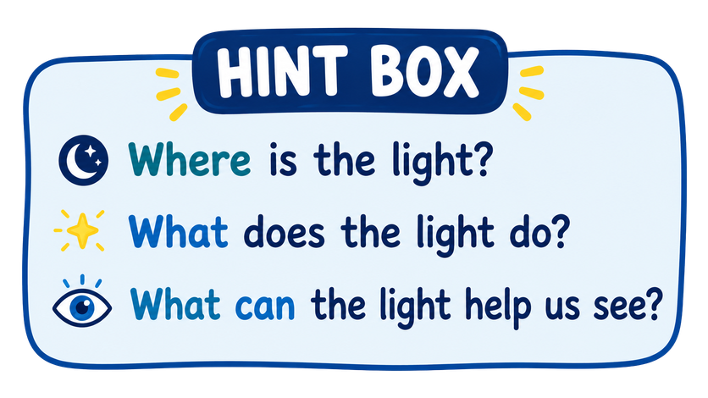
Your mission: Look at the picture. Find words connected to LIGHT!
Let’s build a word chain of light words!
CHALLENGE: Write a sentence using 2 of the words from the word chain!
Notes:
Teacher Note: Students can brainstorm a variety of words linked to light.
Have them think about where they see light, how it's made, lots of light vs. little light, how light is created etc.

