Slide 1


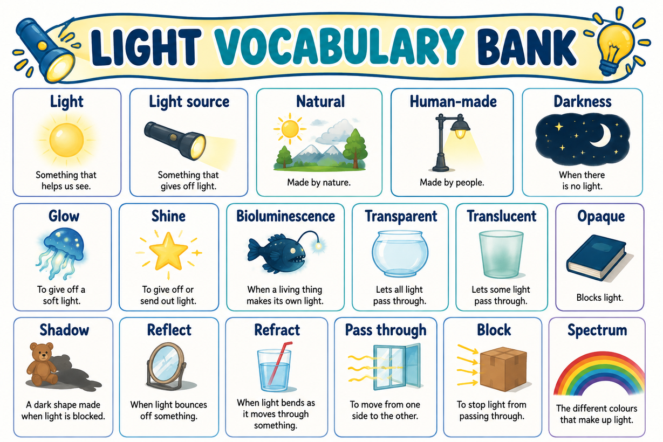
❌ A flashlight is a natural source of light.
✅ A flashlight is a human-made source of light.
Notes:
Teacher Note: Go through all of the vocabulary words as a class. Have your students orally fix each sentence. This can be done as a whole class or with small groups/pairs.

Slide 2
❌ The Sun is a human-made source of light.
✅ The Sun is a natural source of light.

Slide 3
❌ Bioluminescence means an object blocks light.
✅ Bioluminescence is when a living thing makes its own light.

Slide 4
❌ A transparent material blocks all light.
✅ An opaque material blocks all light.

Slide 5
❌ A translucent material lets all light pass through.
✅ A translucent material lets some light pass through.

Slide 6
❌ An opaque object lets some light pass through.
✅ An opaque object lets no light pass through.

Slide 7
❌ When light hits a mirror, it disappears.
✅ When light hits a mirror, it reflects.

Slide 8
❌ A clear plastic cup is opaque because we can see through it.
✅ A clear plastic cup is transparent because we can see though it.

