Slide 1


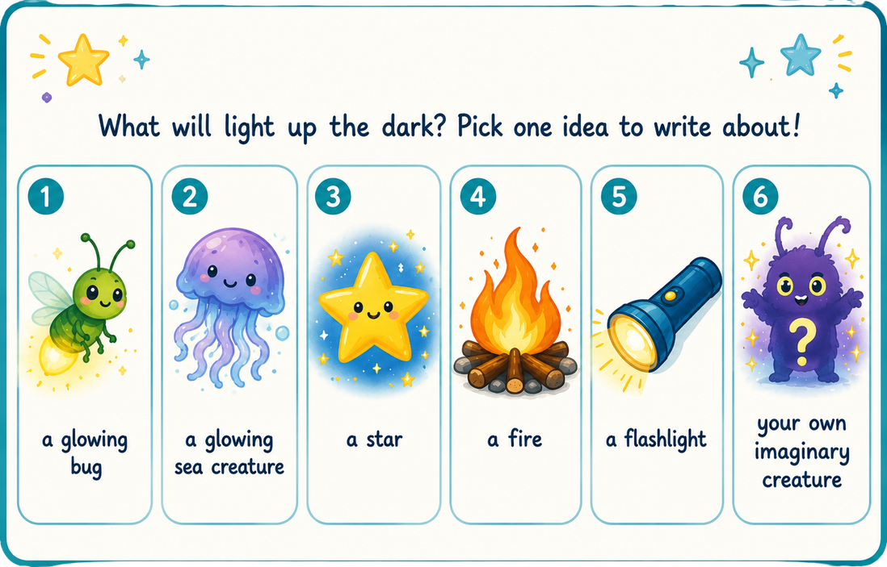
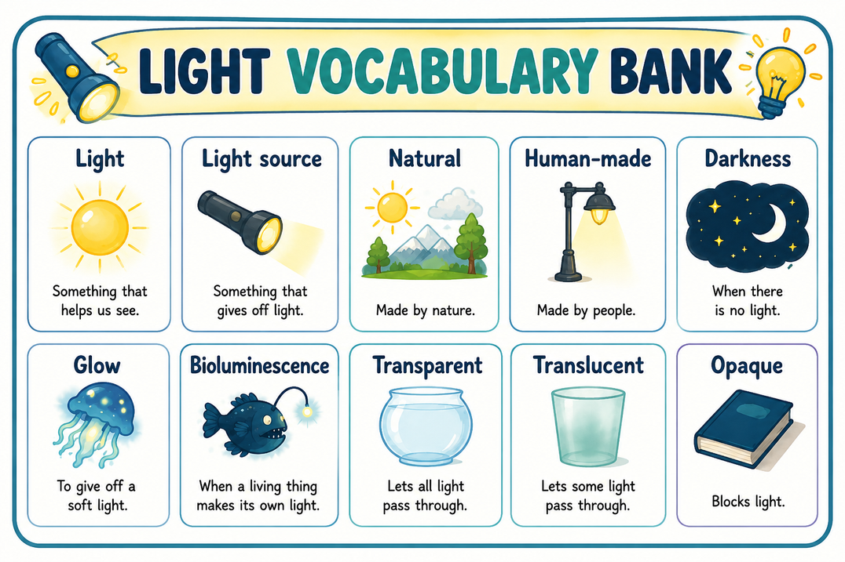
Imagine you are exploring the dark, dark night. Suddenly… you see a mysterious light! Write 3-5 sentences.
Sentence Starters:
It was a dark, dark night...
I saw __________.
It could __________.
I knew it was a __________ source of light because __________.

